Slide 1
Database Systems
External Sorting
何明昕 HE Mingxin, Max
Send your email to c.max@yeah.net with
a subject like: DBS345-Andy: On What …
Download from c.program@yeah.net
/文件中心/网盘/DatabaseSystems2021

Slide 2
External Sorting
Old Big Data algorithms!

Slide 3
Recap
Indexes
Tree-based
Good for equality and range searches
Example: B+tree
Height-balanced dynamic tree structure
Insert/delete at log_{F} N cost
Hash-based
Good for equality searches
Static hashing
Dynamic
Example: extendible (global and local depth)
 | a |  | b
 | e |  | f
 | g |  | h |  | i
 | j |  | k |  | l |  | m
3 | A
 | B
 | 3
000
001
010
011
100
101
110
111
2 | C
 | D
2 | E
2
3 | G

Slide 4
Why Sorting?
Users often want the data sorted (ORDER BY)
First step in bulk-loading a B⁺ tree
Used in duplicate elimination
Sort-merge join algorithm involves sorting as a first step
Will see sort-merge join later in the class

Slide 5
Sorting in Databases
How about using sort algorithms (such as merge sort, quick sort, heap sort, etc.)?
Data might not fit into memory
e.g. sort 1 TB of data using 64 MB of main memory!
Generally speaking
In main memory algorithms
We care about CPU time
In databases
Time is dominated by secondary storage (disk) I/O cost
Assumption: cost is determined by I/O
Consequences
Need to redesign certain algorithms
Compute cost using I/O read/writes

Slide 6
Example: Merge Sort
Sorting n tuples needs n log(n) comparisons
If we do a record-based sorting, we will need n log(n) I/Os
Key idea: sort based on pages, not records
Problem
M available mem pages
A relation R with N > M pages
Output a relation R’ sorted on a given sort key
Solution desiderata
Sort large relations using small memory
Minimize disk I/Os
Use sequential I/O rather than random I/O
Overlap I/O and CPU operations, minimizing CPU operations

Slide 7
Warm-up: 2-way External Merge-sort
A run is a sorted sub-file generated in intermediate steps of the sorting algorithm
2-way external merge-sort requires 3 buffer pages
Pass 1: read a page, sort it in memory (internal sorting), write it back
Requires only 1 buffer page
Passes 2, 3, …: read two runs, merge them into one run and write it back
Requires 3 buffer pages

Slide 8
2-way External Merge-sort (Cont.)
Sort
INPUT
Disk
Main memory buffers
Disk
INPUT 1
Merge
OUTPUT
INPUT 2
Disk
Main memory buffers
Disk

Slide 9
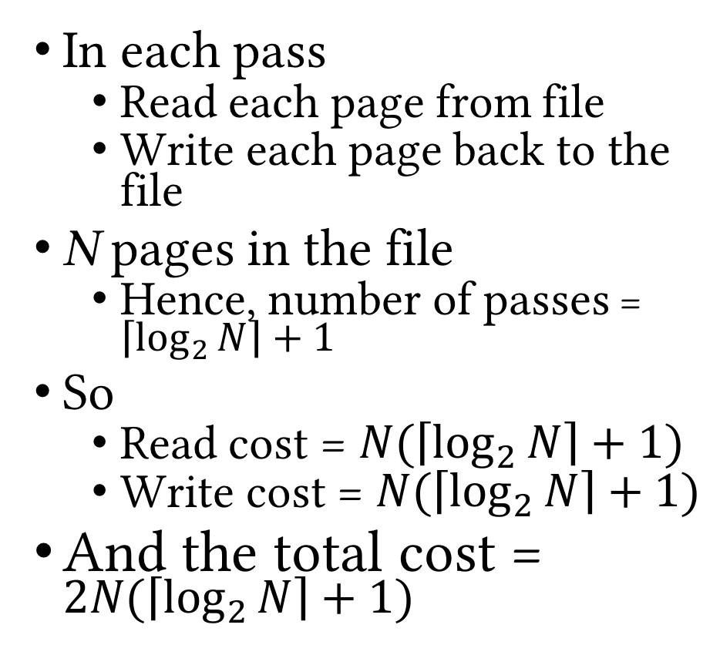
2-way External Merge-sort: Example
In each pass
Read each page from file
Write each page back to the file
N pages in the file
Hence, number of passes = $\left\lceil \log_{2}{N}\right\rceil +1$
So
Read cost = $N(\left\lceil \log_{2}{N}\right\rceil +1)$
Write cost = $N(\left\lceil \log_{2}{N}\right\rceil +1)$
And the total cost = $2N(\left\lceil \log_{2}{N}\right\rceil +1)$
3,4
6,2
9,4
8,7
5,6
3,1
2
Input file
Pass 0
3,4
2,6
4,9
7,8
5,6
1,3
2
1-page runs
Pass 1
2,3
4,7
1,3
4,6
8,9
5,6
2
2-page runs
Pass 2
2,3
4,4
1,2
4-page runs
6,7
3,5
8,9
6
Pass 3
1,2
2,3
3,4
8-page runs
4,5
6,6
7,8
9

Slide 10
Example
Sorting a relation R with
1,000,000 records
Each record has 32 bytes
Each page has 8KB
What is the cost of 2-way merge-sort on R?
Usually have more than 3 pages of memory available
Can improve performance by reducing number of passes necessary to finish the sort
Notes:
1 page = 8000/32 = 1000/4 = 250 records
R = 1M/250 = 4M/1000= 4000 pages
cost = 2*4000 (log 4000 + 1) = 2*4000*13 = 104000 I/Os

Slide 11
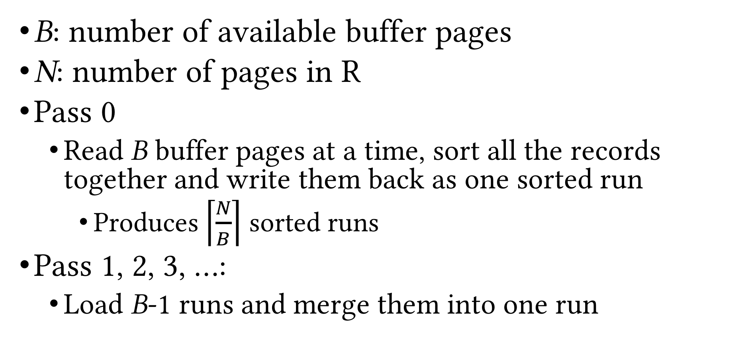
General (Multi-way) External Merge-sort
B: number of available buffer pages
N: number of pages in R
Pass 0
Read B buffer pages at a time, sort all the records together and write them back as one sorted run
Produces $\left\lceil \frac{N}{B}\right\rceil$ sorted runs
Pass 1, 2, 3, …:
Load B-1 runs and merge them into one run

Slide 12
External Merge-sort (Cont.)
INPUT 1
Sort
INPUT 2
…
…
…
Disk
INPUT B
Disk
INPUT 1
Merge
INPUT 2
OUTPUT
…
…
INPUT B-1
Disk
Disk

Slide 13
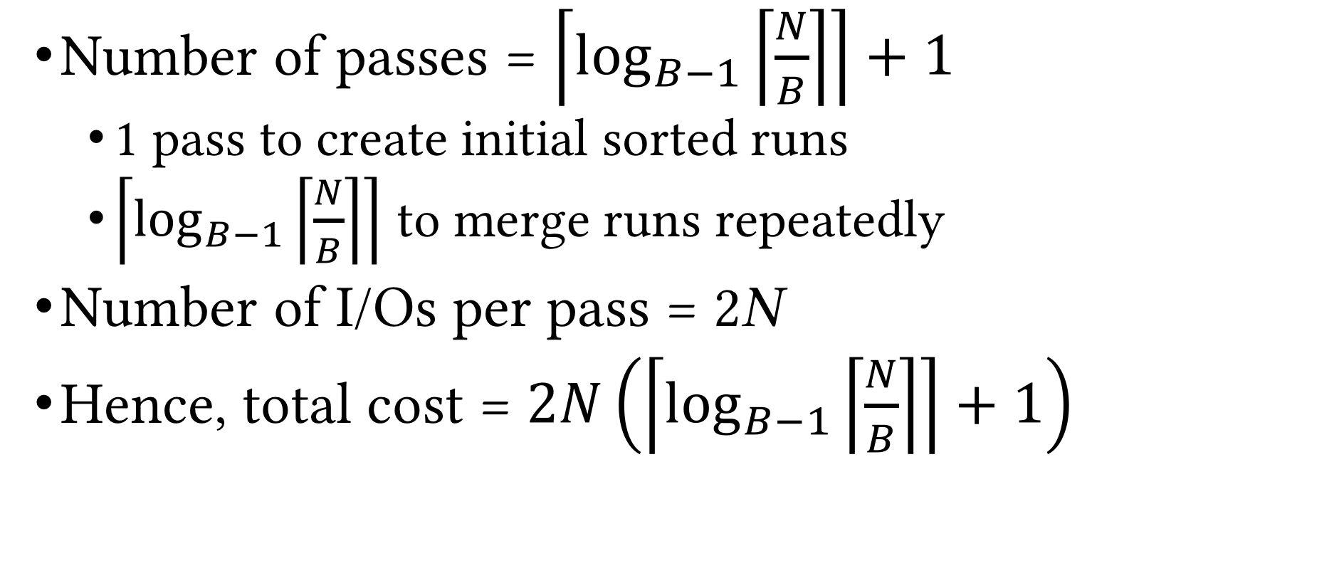
External Merge-sort (Cont.)
Number of passes = $\left\lceil \log_{B−1}\left\lceil \frac{N}{B}\right\rceil \right\rceil +1$
1 pass to create initial sorted runs
$\left\lceil \log_{B−1}\left\lceil \frac{N}{B}\right\rceil \right\rceil$ to merge runs repeatedly
Number of I/Os per pass = 2N
Hence, total cost = $2N\left(\left\lceil \log_{B−1}\left\lceil \frac{N}{B}\right\rceil \right\rceil +1\right)$

Slide 14
Example: Revisited
Sorting a relation R with
1,000,000 records
Each record has 32 bytes
Each page has 8KB
100 pages available in main memory
What is the cost of merge-sort on R?

Slide 15
Number of Passes
N | B=3 | B=17 | B=257
100 | 7 | 2 | 1
10,000 | 13 | 4 | 2
1,000,000 | 20 | 5 | 3
10,000,000 | 23 | 6 | 3
100,000,000 | 26 | 7 | 4
1,000,000,000 | 30 | 8 | 4

Slide 16
Improvements
Replacement sort
An alternative for sorting in pass 0
Creates runs of average size 2B
Blocked I/O
Read/write pages in sequential blocks
Reduces I/O cost per page
Double-buffering
Keep a second set of buffers so that I/O and CPU can overlap

Slide 17
Using Replacement Sort
Example
B=4
1 page for input, 1 page for output, 2 pages for data
Number of tuples per page = 2
10
20
30
40
25
35
9
8
Input Buffer
Output Buffer
7
6
Data Buffers
5
50
Input File
Pass 0 Runs

Slide 18
Using Replacement Sort (Cont.)
Example
B=4
1 page for input, 1 page for output, 2 pages for data
Number of tuples per page = 2
10
20
25
35
30
40
9
8
Input Buffer
Output Buffer
7
6
Data Buffers
5
50
Input File
Pass 0 Runs

Slide 19
Using Replacement Sort (Cont.)
Example
B=4
1 page for input, 1 page for output, 2 pages for data
Number of tuples per page = 2
20
25
35
10
30
40
9
8
Input Buffer
Output Buffer
7
6
Data Buffers
5
50
Input File
Pass 0 Runs

Slide 20
Using Replacement Sort (Cont.)
Example
B=4
1 page for input, 1 page for output, 2 pages for data
Number of tuples per page = 2
25
30
10
20
35
40
9
8
Input Buffer
Output Buffer
7
6
Data Buffers
5
50
Input File
Pass 0 Runs

Slide 21
Using Replacement Sort (Cont.)
Example
B=4
1 page for input, 1 page for output, 2 pages for data
Number of tuples per page = 2
10
20
25
30
9
8
35
40
Input Buffer
Output Buffer
7
6
Data Buffers
5
50
Input File
Pass 0 Runs

Slide 22
Using Replacement Sort (Cont.)
Example
B=4
1 page for input, 1 page for output, 2 pages for data
Number of tuples per page = 2
10
20
9
30
8
25
35
40
Input Buffer
Output Buffer
7
6
Data Buffers
5
50
Input File
Pass 0 Runs

Slide 23
Using Replacement Sort (Cont.)
Example
B=4
1 page for input, 1 page for output, 2 pages for data
Number of tuples per page = 2
10
20
8
9
25
30
35
40
Input Buffer
Output Buffer
7
6
Data Buffers
5
50
Input File
Pass 0 Runs

Slide 24
Using Replacement Sort (Cont.)
Example
B=4
1 page for input, 1 page for output, 2 pages for data
Number of tuples per page = 2
10
20
25
30
8
9
7
6
35
40
Input Buffer
Output Buffer
Data Buffers
5
50
Input File
Pass 0 Runs

Slide 25
Using Replacement Sort (Cont.)
Example
B=4
1 page for input, 1 page for output, 2 pages for data
Number of tuples per page = 2
10
20
25
30
7
8
6
35
9
40
Input Buffer
Output Buffer
Data Buffers
5
50
Input File
Pass 0 Runs

Slide 26
Using Replacement Sort (Cont.)
Example
B=4
1 page for input, 1 page for output, 2 pages for data
Number of tuples per page = 2
10
20
25
30
6
7
35
40
8
9
Input Buffer
Output Buffer
Data Buffers
5
50
Input File
Pass 0 Runs

Slide 27
Using Replacement Sort (Cont.)
Example
B=4
1 page for input, 1 page for output, 2 pages for data
Number of tuples per page = 2
10
20
25
30
Run 1
6
7
35
40
5
50
8
9
Input Buffer
Output Buffer
Data Buffers
Input File
Pass 0 Runs

Slide 28
Using Replacement Sort (Cont.)
Example
B=4
1 page for input, 1 page for output, 2 pages for data
Number of tuples per page = 2
10
20
25
30
Run 1
6
7
35
40
50
5
8
9
Input Buffer
Output Buffer
Data Buffers
Input File
Pass 0 Runs

Slide 29
Using Replacement Sort (Cont.)
Example
B=4
1 page for input, 1 page for output, 2 pages for data
Number of tuples per page = 2
10
20
25
30
Run 1
7
8
35
40
5
6
9
50
Input Buffer
Output Buffer
Data Buffers
Input File
Pass 0 Runs

Slide 30
Using Replacement Sort (Cont.)
Example
B=4
1 page for input, 1 page for output, 2 pages for data
Number of tuples per page = 2
10
20
25
30
Run 1
35
40
5
6
Input Buffer
Output Buffer
Data Buffers
7
8
Run 2
9
50
Input File
Pass 0 Runs

Slide 31
Using Replacement Sort (Cont.)
Also called tournament sort or heapsort
Average length of a run in replacement sort = 2B
Algorithm
Read B-2 pages in memory (keep as sorted heap)
Move smallest record (that is greater than the largest element in the current run) to output buffer
Read a new record and insert into the sorted heap
Quick Sort is also a fast way to sort in memory
Replacement sort creates longer runs, hence fewer passes on over the data

Slide 32
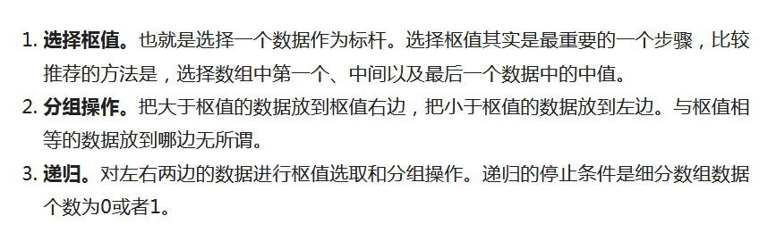
Review: Quiksort (by Tony Hoare)
https://www.toutiao.com/a6751314863827452429
为什么说快速排序是最快排序算法？ (Really?)
分治(divide and conquer):

Slide 33
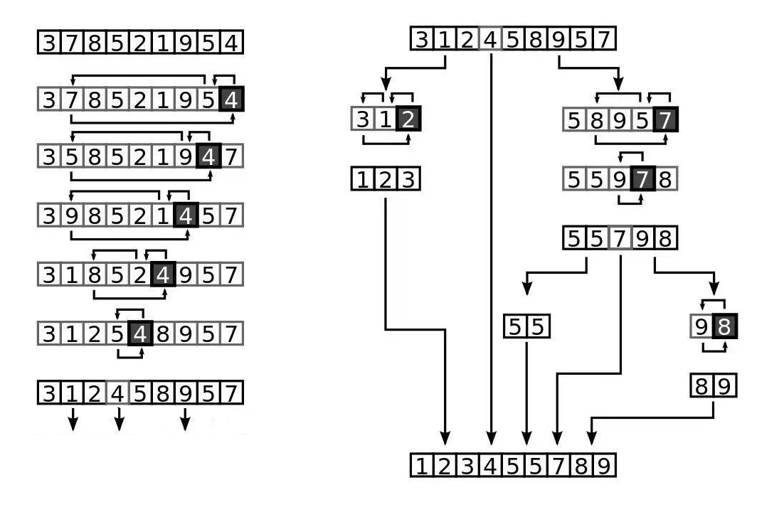

Slide 34
How to select Pivots
Lomuto分组方案
最简单也是最常见的分组方式是Lomuto分组方案，该方案直接选取最后一个元素作为枢值，该方案最明显的缺点是，当一个数组已经是有序的或者数组所有数字相同，反而会出现最糟糕的排序情况，即复杂度为O(n2)。
Hoare分组方案
Hoare的分组方案，通过一定的方法选择一个枢值，一般选择数组中间的值，不妨设数组A首尾元素的下标分别为lo和hi，则枢值
Pivot = A[(lo + hi) / 2]
为了避免整数溢出问题，一般写成
Pivot = A[lo + (hi - lo) / 2]
其他分组方案
Mo3(A) = median(A[1], A[n/2], A[n])
ninther(a) = median(Mo3(first 1/3 of a), Mo3(middle 1/3 of a), Mo3(final 1/3 of a))

Slide 35
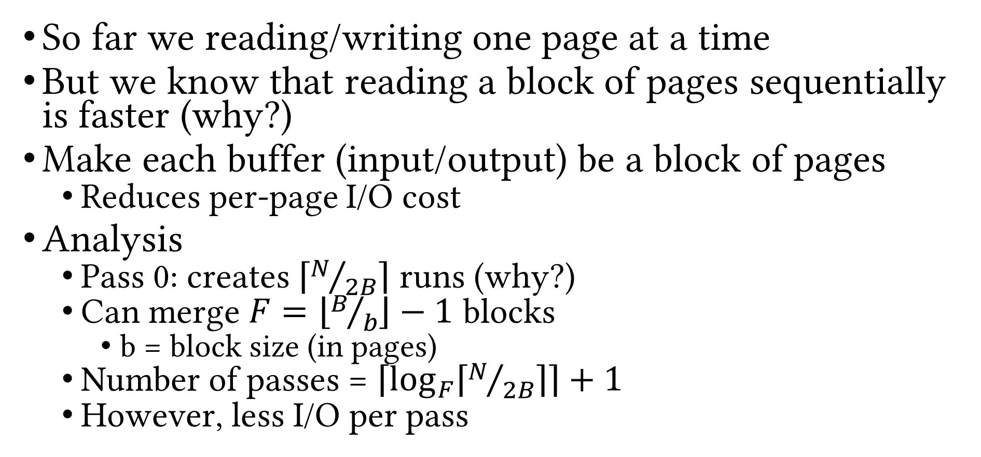
Using Blocked I/O
So far we reading/writing one page at a time
But we know that reading a block of pages sequentially is faster (why?)
Make each buffer (input/output) be a block of pages
Reduces per-page I/O cost
Analysis
Pass 0: creates $\left\lceil N/{2B}\right\rceil$ runs (why?)
Can merge $F=\left\lfloor B/b\right\rfloor −1$ blocks
b = block size (in pages)
Number of passes = $\left\lceil \log_{F}\left\lceil N/{2B}\right\rceil \right\rceil +1$
However, less I/O per pass

Slide 36
Using Double-buffering
So far we have considered only I/O costs
But CPU may have to wait for I/O
Keep a second set of buffers (shadow buffers/blocks) so that I/O and CPU overlap
INPUT 1
INPUT 1’
Merge
INPUT 2
…
INPUT 2’
OUTPUT
…
…
OUTPUT’
Disk
INPUT k
INPUT k’

Slide 37
Using B⁺ trees for Sorting
What if there exists a B+tree for the sort key?
Keys are already sorted!
But would it be useful for sorting the data?
Two possibilities
Clustered B+tree
Retrieve leftmost entry, sweep through leaf pages in order
Cost
If data is not in the index
Height + #leaf pages in index + #data pages
If data is in the index
Height + #leaf pages in index
Unclustered B+tree
Worst-case: as many I/Os as the number of records!
Even in average case, it is slower than external merge-sort

Slide 38
Summary
External sorting is important
DBMS may dedicate part of buffer pool for sorting!
External merge-sort minimizes disk I/O cost
Pass 0: produces sorted runs of size B (number of buffer pages)
Later passes: merge runs
Number of runs merged at a time depends on B and block size
Larger block size means
Less I/O cost per page
Smaller number of runs merged
In practice, number of runs rarely more than 2 or 3
Notes:
19

Slide 39
Summary (Cont.)
Choice of internal sort algorithm may matter
Quicksort: Quick!
Replacement sort: slower, longer runs
Clustered B+ tree is good for sorting
Unclustered tree is usually very bad

Slide 40
Summary (Cont.)
Sorting is a competitive sport!
See http://sortbenchmark.org/
Task is to sort 100-byte records
Different flavors of metrics that people compete on
Sort at trillion records as fast as you can
Using general purpose sorting code (Daytona) or
Code specialized just for the benchmark (Indy)
2016 records: sorted 100TB in about 100 seconds!!!

Slide 41
Relational Operators
Next Up
Questions?

